Slide 1
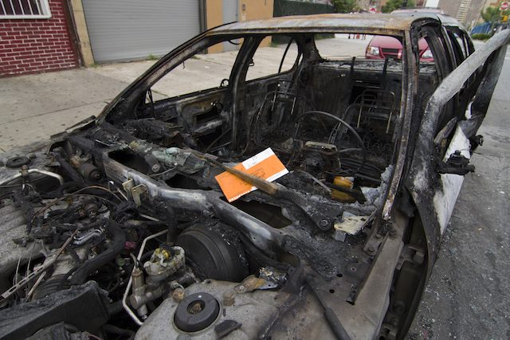
New York City Parking Violations
Visualization of Ticket Issuances
Using R and ggplot2

Slide 2
Summary
New York City offers detailed parking violations information through the NYC Open Data initiative, https://nycopendata.socrata.com/
This analysis includes tickets issued for FY 2016:
https://data.cityofnewyork.us/City-Government/Parking-Violations-Issued-Fiscal-Year-2016/kiv2-tbus
In spite of the title, the data appears to stretch from 1/1/15 thru 12/31/16.
The selected subset of data encompasses 7.4 million records.

Slide 3
Issues
Entire database is discrete data
Solution: None. I’ve got no continuous charts…
Large database makes data-analysis time consuming
Solution: analysis encompasses Manhattan only, about ½ dataset
Data is not clean: Missing values, incorrect factors
Solution: missing values are excluded only if they are plotted in the chart. Otherwise, all records are included in the charts.

Slide 4
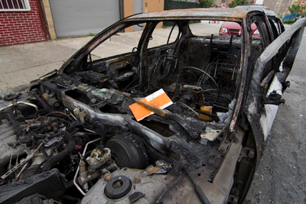
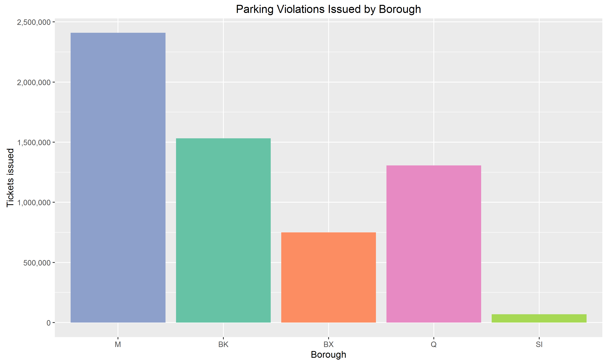

Slide 5
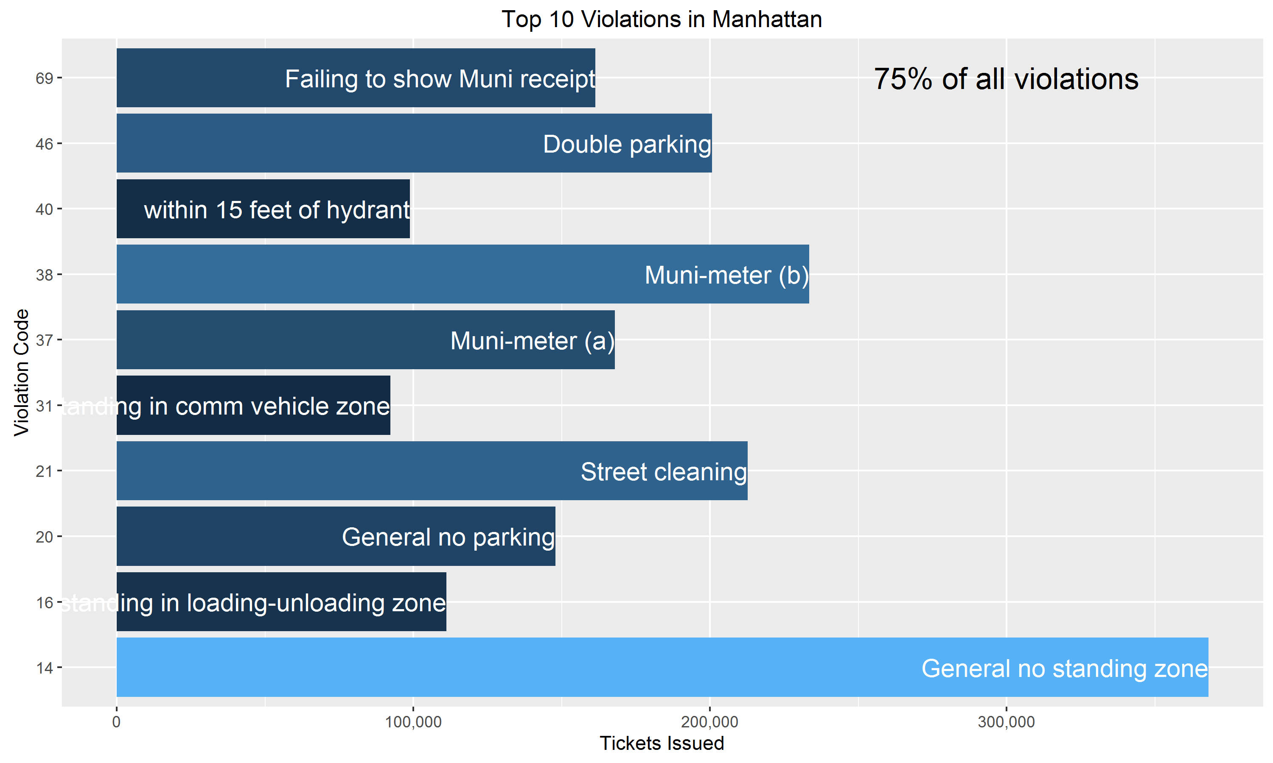

Slide 6
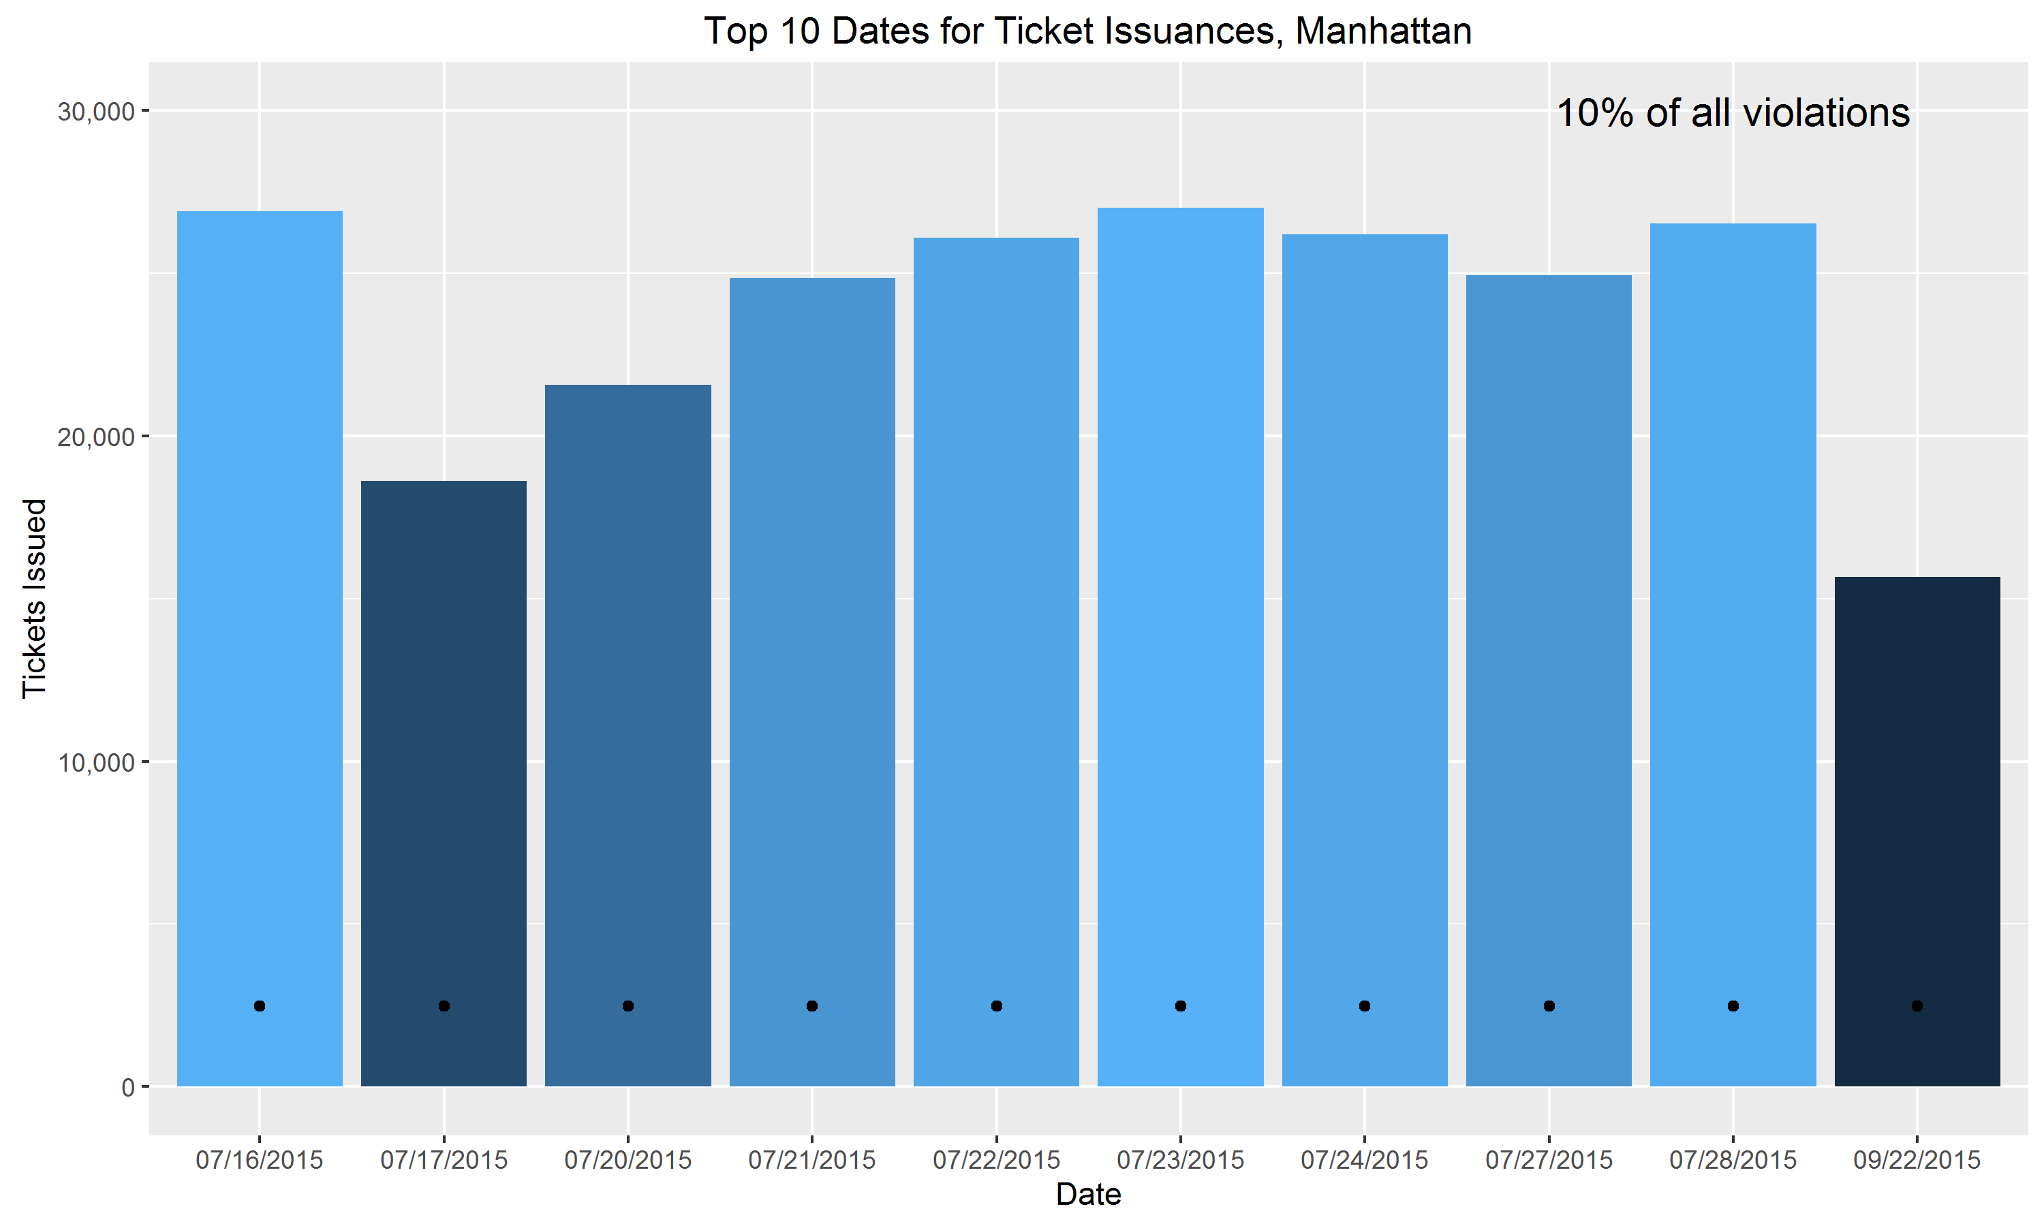

Slide 7
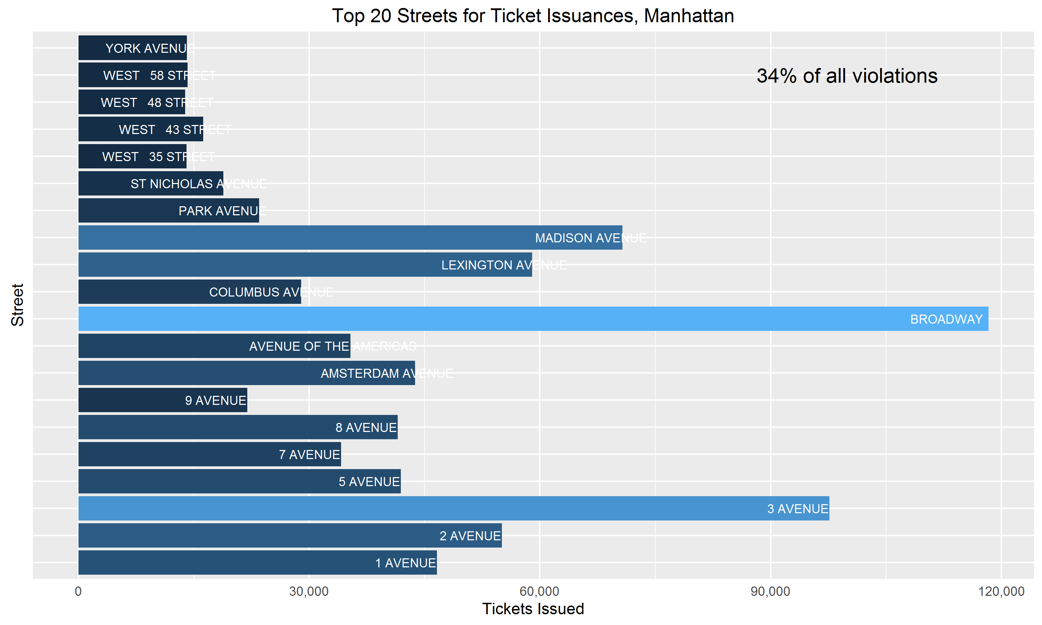

Slide 8
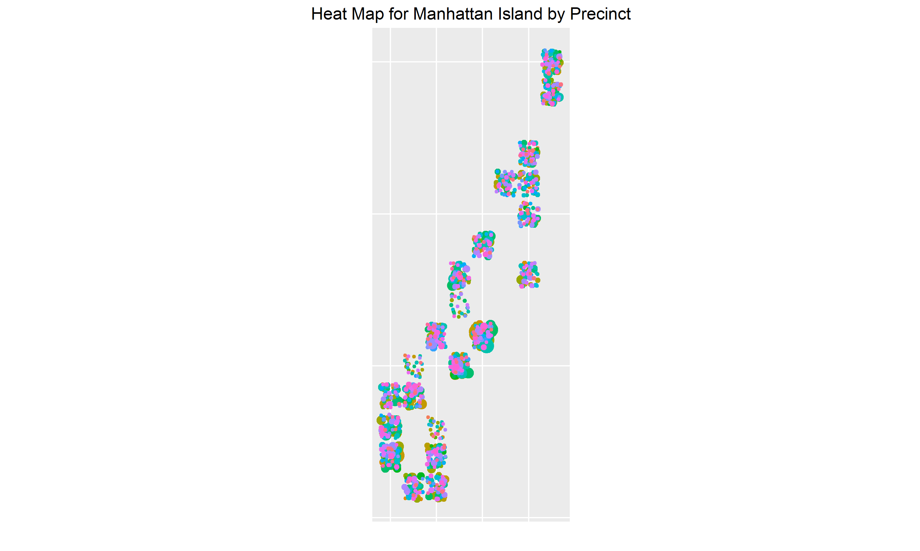

Slide 9
Recipients of Parking Tickets Happy vs. Unhappy

Slide 10
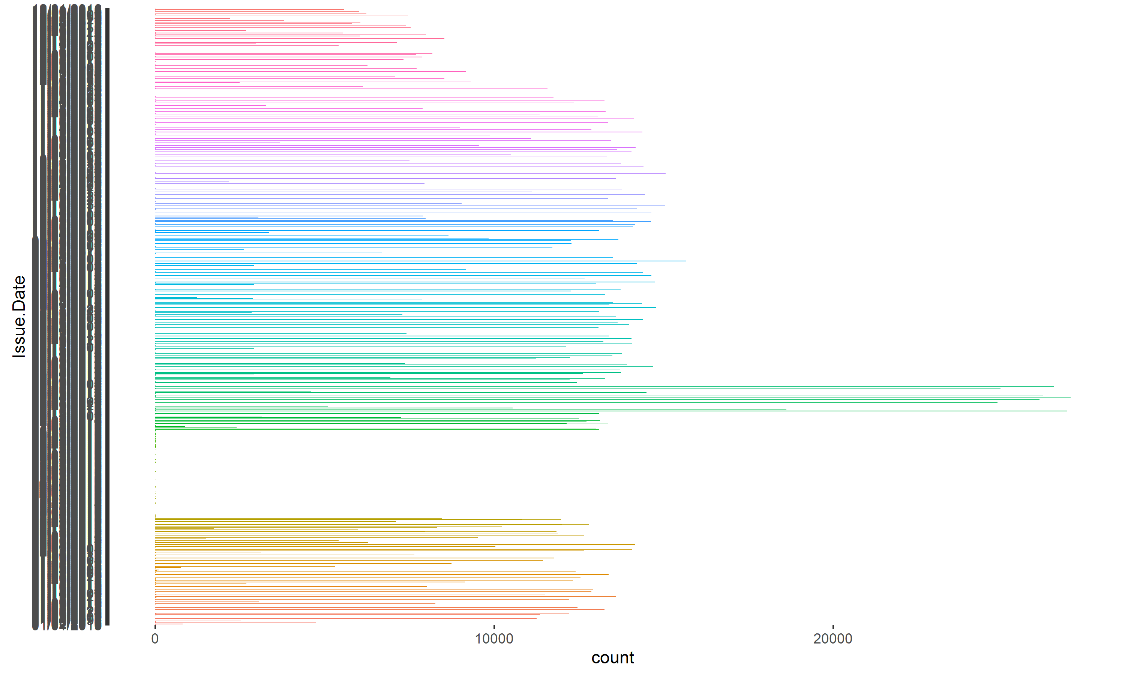
Supporting Slides

Slide 11
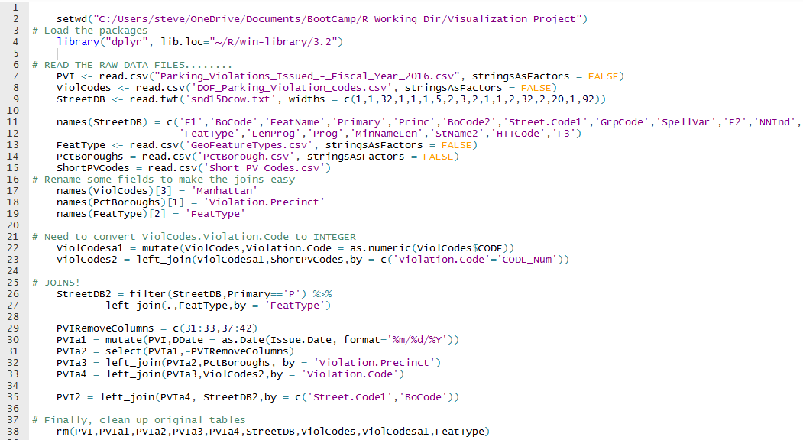
Code to Load Data

Slide 12
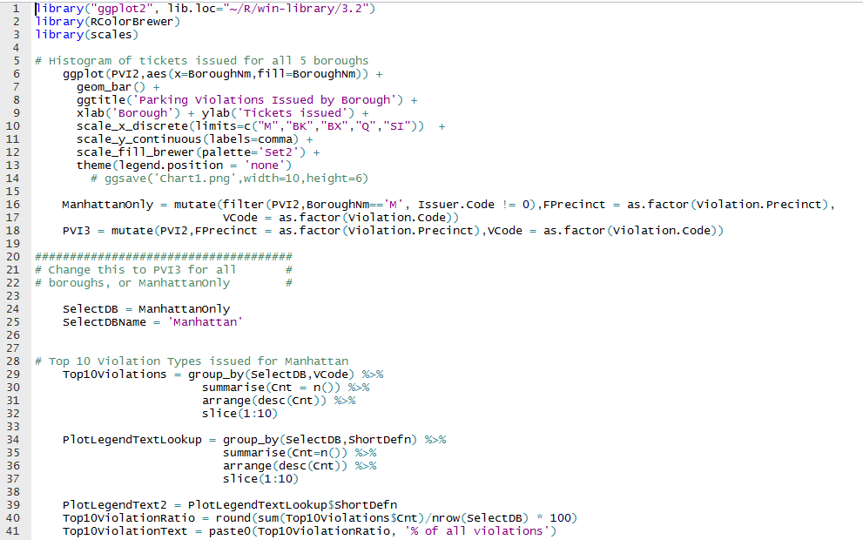
Code to Create Charts
Steven Ginzberg

Slide 13
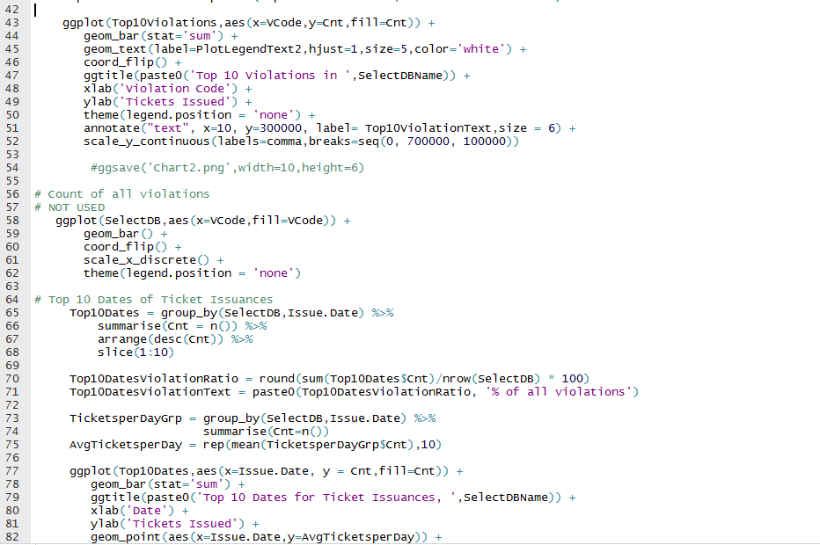
Code to Create Charts, 2

Slide 14
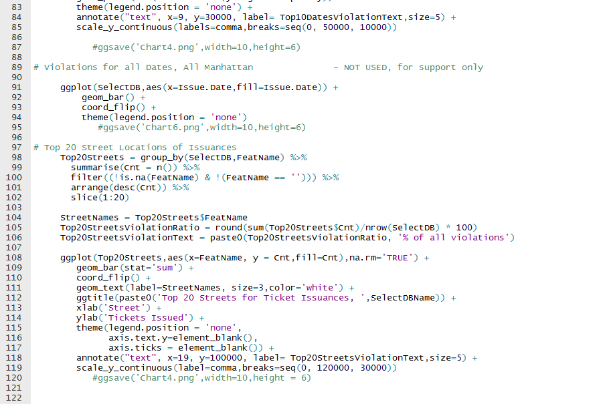
Code to Create Charts, 3

